Slide 1
List Rendering in React

Slide 2
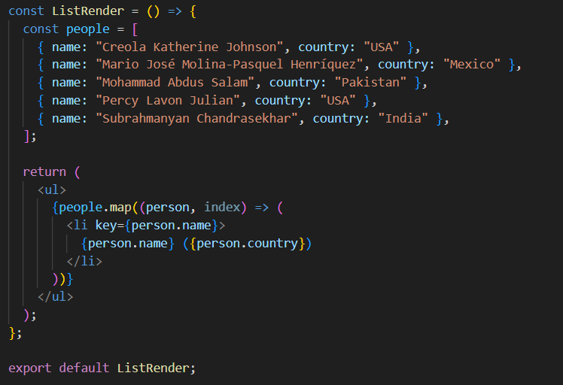

Slide 3
Lifting State Up

Slide 4
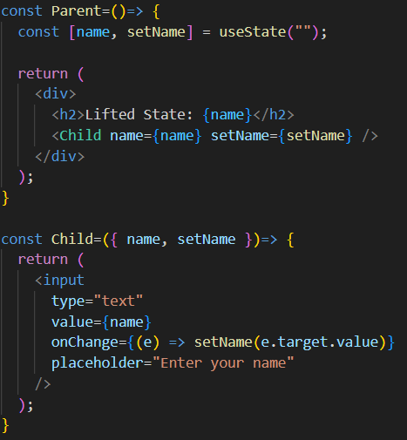
Lifting State Up
Lifting state up means moving state from a child component to a common ancestor so multiple components can share it. Here's a simple example:

Slide 5
Prop Drilling

Slide 6
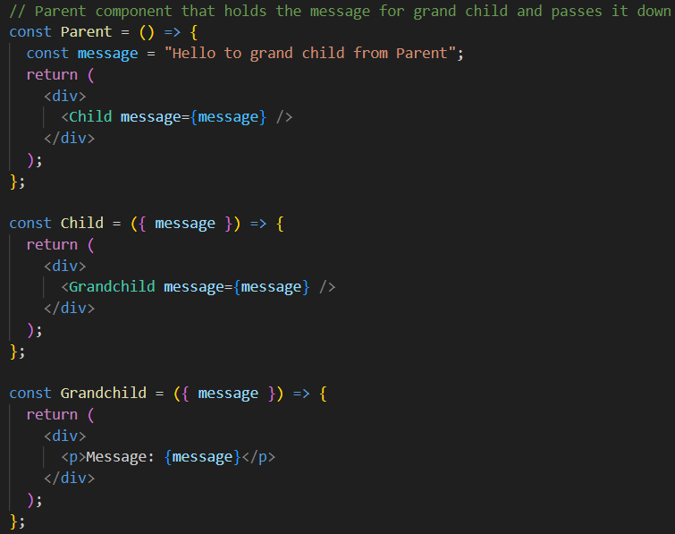
Prop Drilling
Prop drilling in React refers to the process of passing data (props) from a parent component down to deeply nested child components through multiple intermediate components, even if those intermediate components do not directly use the data.
This can lead to unnecessary complexity and reduced maintainability.

Slide 7
Prop Drilling
Prop drilling can occur when the state is lifted.
To avoid prop drilling, use context API or a global state management library, such as redux, zustand, etc.

Slide 8
Queueing a Series of State Updates
https://react.dev/learn/queueing-a-series-of-state-updates

Slide 9
State Update Batching
import { useState } from 'react';
export default function Counter() {
const [number, setNumber] = useState(0);
return (
<>
<h1>{number}</h1>
<button onClick={() => {
setNumber(number + 1);
setNumber(number + 1);
setNumber(number + 1);
}}>+3</button>
</>
)
}

Slide 10
State Update Batching
In this code, when the button is clicked, you expect number to increase by 3. However, due to React's state batching behavior, the final value of number may not be what you expect.
How React Processes the Updates
The initial state is number = 0.
When the button is clicked, the event handler runs:
setNumber(number + 1);
setNumber(number + 1);
setNumber(number + 1);
Each state update call is put to a queue (batched) by react, i.e., the state update is not immediately reflected, it is deferred till the event listener has finished executing. As state update call sees 0 as the value of the number.
State updates are batched for efficient rendering, i.e, apply all state updates in one go and do a single rerender.

Slide 11
State Update Batching
To ensure that you get the updated value of state inside the setState function, use callback approach, i.e.,
setNumber(prev => prev + 1);
`prev` will be the updated value of number, i.e., the number you would get if all previous state updates were applied immediately.
State updates are still being batched in callback approach.
Callback approach is better for state updates in functional components.

Slide 12
State Mutation in React

Slide 13
State Mutation
Mutating the state, i.e., updating and returning the same state object is not allowed in React.
If you need to update the state, you have to return a new state object inside the state update function.
React requires state updates to be immutable.
An immutable state update means creating a new copy of the state with the updated values instead of modifying the existing state directly. React relies on immutability to detect changes and trigger re-renders efficiently.

Slide 14
State Mutation
Suppose we have a state:
const [user, setUser] = useState({ name: "Alice", age: 25 });
Not Allowed:
user.age += 1;
setUser(user); //❌ mutating the existing state object and passing in the update function.
setUser(prev => {
prev.a = 1; // ❌ Mutating the existing state object
return prev; // ❌ Returning the same mutated object
});

Slide 15
State Mutation
Correct Approach
Instead, create a new object, update and return it:
setUser(prevUser => ({ ...prevUser, age: prevUser.age + 1 }));
This spreads the previous state into a new object { ...prev }, ensuring immutability.
React detects the change and re-renders the component.

